Slide 1
FLOWER CLASSIFICATION USING RANDOM FOREST CLASSIFIER
CAPSTONE PROJECT
Presented By:
Student Name : CHERUKUTI GAYATHRI
College Name : MALLA REDDY INSTITUTE OF TECHNOLOGY AND SCIENCE
Department : ELECTRONICS AND COMMUNICATION ENGINEERING

Slide 2
CONTENTS
OBJECTIVE
PROBLEM STATEMENT
INTRODUCTION
LITEARATURE SURVEY
METHODOLOGY
OUTPUT
ADVANTAGES
DISADVANTAGES
APPLICATIONS
CONCLUSION
FUTURE SCOPE

Slide 3
OBJECTIVE
To develop a model which classifies the flowers.
To successfully implement random forest classifier to make a flower classifier with high accuracy.

Slide 4
PROBLEM STATEMENT
Make the classification easier by building a system which automatically classifies flowers based on their species.
Training random forest using random set of flower images.
Testing the system by random images of a particular species.
Identifying the type by passing a flower image as query.

Slide 5
INTRODUCTION
We classify different objects based on our perception of it’s shape, smell, size, color, uses. This ability helped us in understanding our environment, build and create new things which made significant impact on our lives. But classification of things which are abundant and look very similar is complex. To classify such things we should have vast knowledge of those things.
Other than decorative purposes, flowers have significant uses important for animal survival including humans. They support basic functions by providing food, nutrition and also have medicinal uses.

Slide 6
LITERATURE SURVEY
David W. Corne and Ziauddin Ursani proposed in their paper “an evolutionary algorithm for nonlinear discriminant classifier”. They tested this method on two data sets, Flower and Balance Scale.They concluded decisions of class membership can only be affected collectively by individual lineaments of flower.
Detlef Nauck and Rudolf Kruse have proposed a new approach in which they classify the data on the basis of fuzzy Neural Networks. They concluded that on increasing the number on hidden layer, increase the need of more training cycles and raises incorrect results.
Lakhdoura and Elayachi compared the performance of two classifiers methods: J48 (c4.5) and RF on the IRIS features. The findings showed that RF classifier has 95.55% accuracy.

Slide 7
TOOLS REQUIRED
Python Version 3.10
OpenCV
NumPy
Scikit-learn

Slide 8
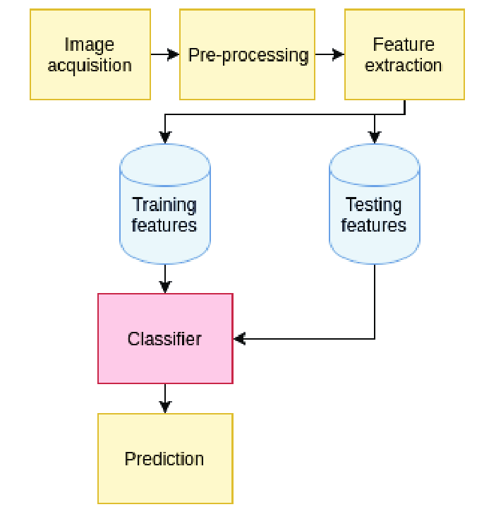
METHODOLOGY

Slide 9
METHODOLOGY
IMAGE ACQUISION:
User can input any flower image into the system. The input image will be resized to 500 x 500 pixels for convenience in processing. The pictures are divided into four classes: Daisy, pansy, crocus, sunflower. For each class there are about 60 photos.
PREPROCESSING
The acquired input image is subjected to a number of prefatory processing steps to make it functional to the descriptive stages of recognition process. The intention of Pre-processing is to produce data that are readable for the recognition systems to operate precisely.

Slide 10
FEATURES EXTRACT :
Feature extraction process involves of extracting a set of features and differentiating the object features from raw background.
When we see a flower, the first thing that we observe is the color of petals. Color is therefore a primary classifier for flower.
In our system, we use RGB Histogram, a histogram of red, green and blue luminance, to characterize each flower image.

Slide 11
CLASSIFICATION :
Classification model was created from training dataset and testing dataset by Random Forest Classifier.
The classification model was created from training dataset and testing dataset by Random Forest Classifier. The Random Forests consists of a collection of tree-structured classifiers.
The RF algorithm establishes the outcome based on the predictions of the decision trees. It predicts by taking the average or mean of the output from various trees. Increasing the number of trees increases the precision of the outcome.

Slide 12
RECOGNIZATION:
Last stage is classification where RF classifier is used.
The RF algorithm establishes the outcome based on the predictions of the decision trees.
It predicts by taking the average or mean of the output from various trees.
Increasing the number of trees increases the precision of the outcome.

Slide 13
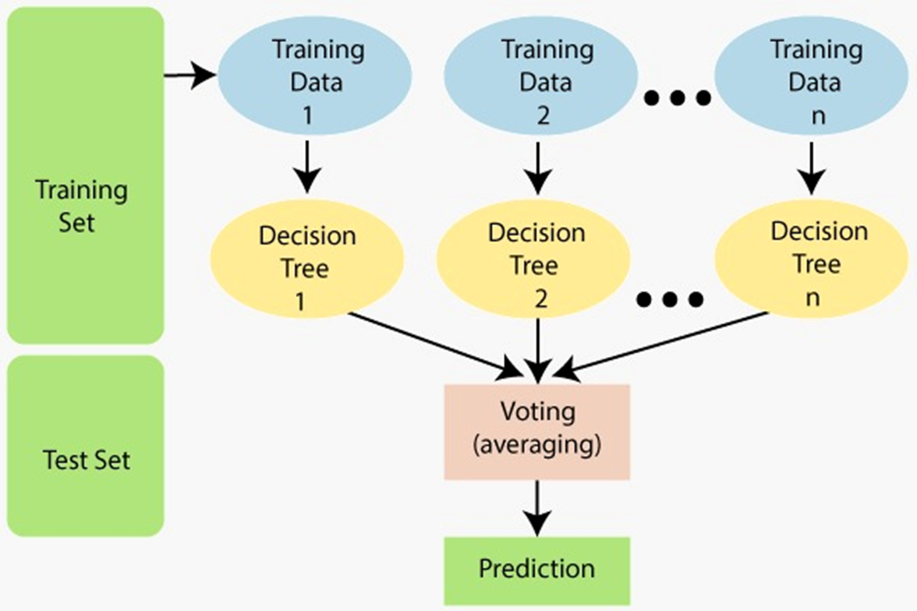
RANDOM FOREST CLASSIFIER
Random Forest is a popular machine learning algorithm that belongs to the supervised learning technique. It can be used for both Classification and Regression problems in ML. It is based on the concept of ensemble learning, which is a process of combining multiple classifiers to solve a complex problem and to improve the performance of the model.
As the name suggests, "Random Forest is a classifier that contains a number of decision trees on various subsets of the given dataset and takes the average to improve the predictive accuracy of that dataset." Instead of relying on one decision tree, the random forest takes the prediction from each tree and based on the majority votes of predictions, and it predicts the final output.

Slide 14
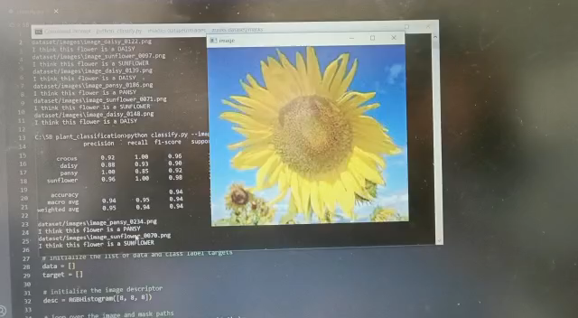
OUTPUT

Slide 15
APPLICATIONS
In floriculture industry : comprises flower trade, nursery and potted plants, seed and bulb production, micro propagation, and extraction of essential oil from flowers. In such cases, automation of flower classification is essential
Flower classification is used for searching patent flower images.
It is also used in honey industry and botanical organizations.

Slide 16
ADVANTAGES & DISADVANTAGES
ADVANTAGES:
Can handle large data sets
Accuracy
Unbiased
Fast recognition
DISADVANTAGES:
Cost
Training is time consuming

Slide 17
CONCLUSION
Here, we presented a system that classify flower from the input image.
RGB Histogram was used as feature points of each flowers in the training set and input set.
Random Forest algorithm was used as our classification The efficiency of flower classification depends on the training data.
The bigger variable the training dataset, the more efficient the system. process.

Slide 18
FUTURE SCOPE
Future scope includes using other features of the flowers in classification, for example, texture and shapes.
Other method for classification can be explored to provide more accuracy.
Also, the database should be improved to contain more data.
Hence the system is simple to implement, therefore, it can be used for other objects that has color as the main property as well

Slide 19
THANK YOU

